Slide 1
Power & Electrical Energy

Slide 2
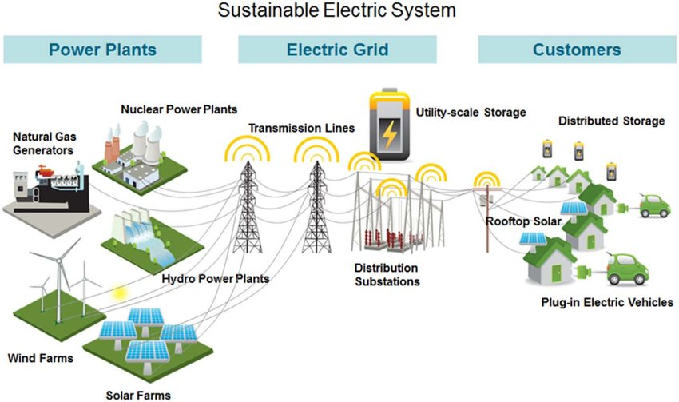
What is Electrical Power?
Where do we get the electricity that powers our homes and businesses on a daily basis, 24/7?

Slide 3
Power
Power = Rate at which work is done where:
P = 1 Joule/second = 1 Watt
P = VI = (1 Volt)•(1 Ampere) = 1 Watt
$$P=VI$$
V = W/q = 1 Joule/Coulomb
I = q/t = 1 Coulomb/second
Since $V=IR$and $I=V/R$:
$$P=IRI=I2R$$
$$P=V∙V/R=V2/R$$

Slide 4
Example (Power)
What is the power rating of a lightbulb in circuit where the current is 0.50 A and the voltage is 120V?
$$P=VI$$
$$P = 120V∙0.50A$$
$$P=60 V∙A=60W$$

Slide 5
Power vs. Current and Power vs. Voltage (Ohmic Materials)
What is the relationship between:
power and current? Power and voltage?
Power
Power
Current
Voltage
$$P=I2R$$
$$P=V2/R$$
The resistance is constant for Ohmic materials.

Slide 6
Energy
Since power is the rate at which work is done the amount of energy required to complete a task is as follows:
Total Energy = Power x time
$W=Pt$
$$W=VIt=I2R=\frac{V2}{R}t$$
Recall that $V=IR$and $I=V/R$

Slide 7
Example (Energy)
How much energy is consumed by a lightbulb operating in circuit where the current is 0.50 A and the voltage is 120V for 1 hour?
$$W=VIt$$
$$W=120V∙0.50A∙3600s$$
$$W=216,000 J$$
$$W=216 kJ$$

